Slide 1


How to Rapidly Deploy a Telehealth Cancer Genetics Program

Slide 2


Agenda
1
Virtual Screening
2
Virtual Genetic Counseling
3
Virtual High Risk Management
4
Funding Opportunities for Virtual Care
5
How to Join a Consortium

Slide 3



Our end-to-end solution
We leveraged our experience working within the top cancer genetics programs in the country – and developed a suite of applications that automate the process
Screen
Evaluate
Manage
Tools to identify high risk patients eligible for genetic evaluation
Workflow automation to streamline the genetic evaluation process
Platform to help patients self-manage genetic predisposition over time

Slide 4
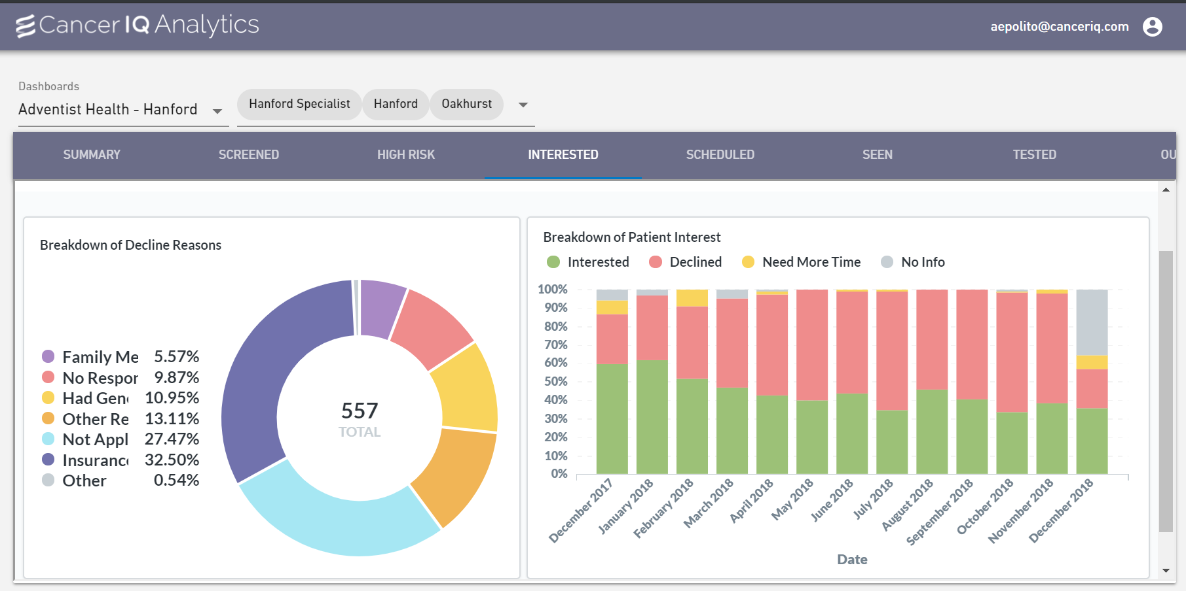
Real-time data to improve quality and drive best practices
Notes:
And lastly, it comes tools for patients to self-manage their risk, engage in early detection strategies, and ultimately prevent cancer
Our clients can offer genetics services to all patients in a fraction of the time and cost

Slide 5


























Select Health Systems We Work With

Slide 6
Identifying High-Risk Patients
At home ways for patients to engage and learn about cancer risk factors

Slide 7
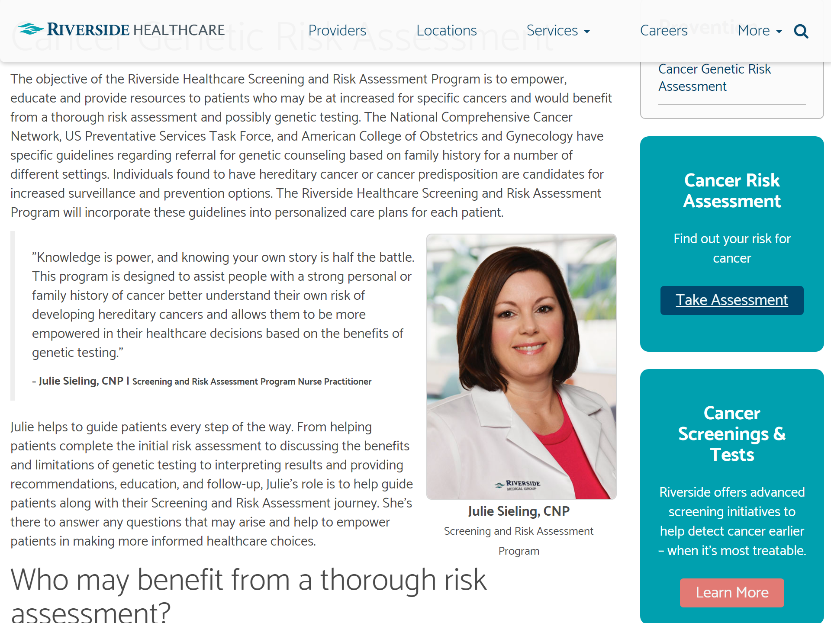
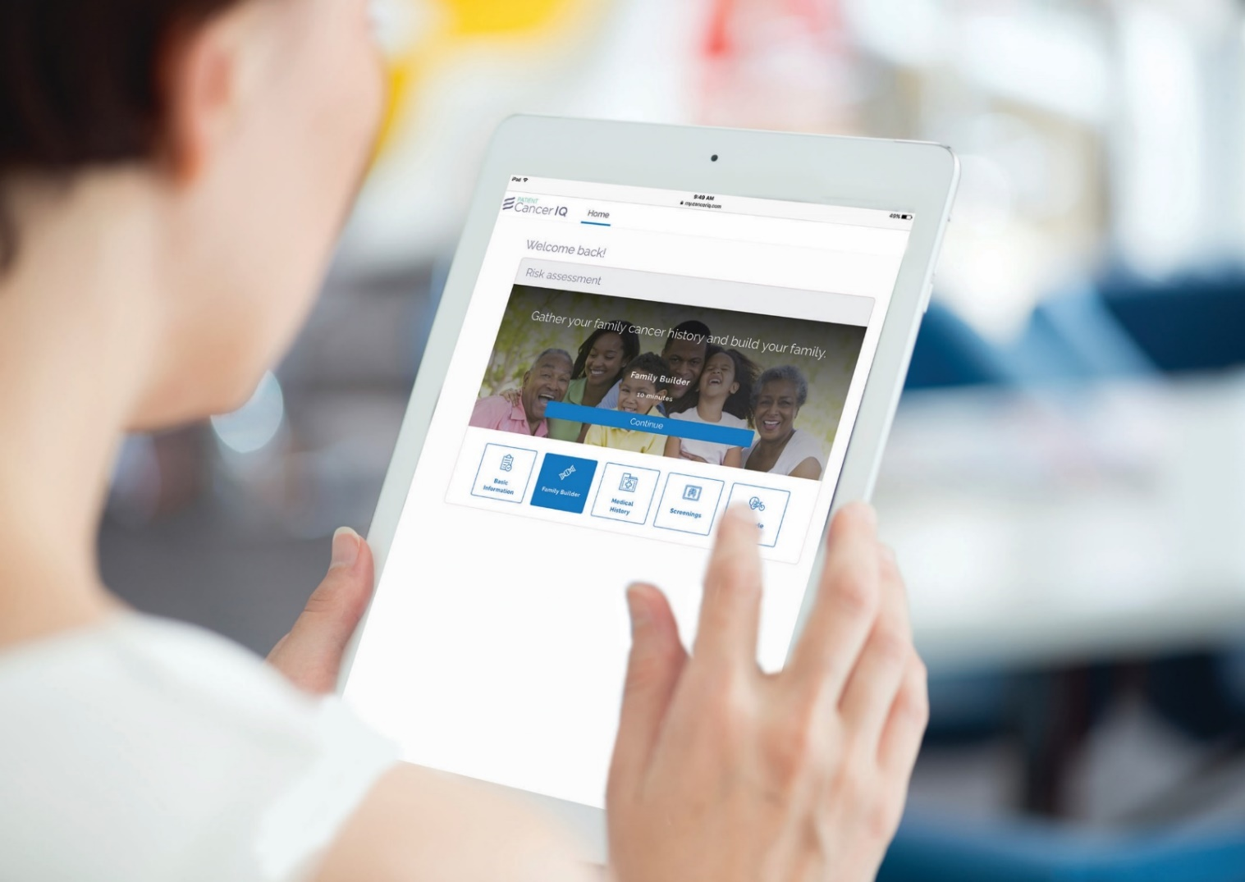
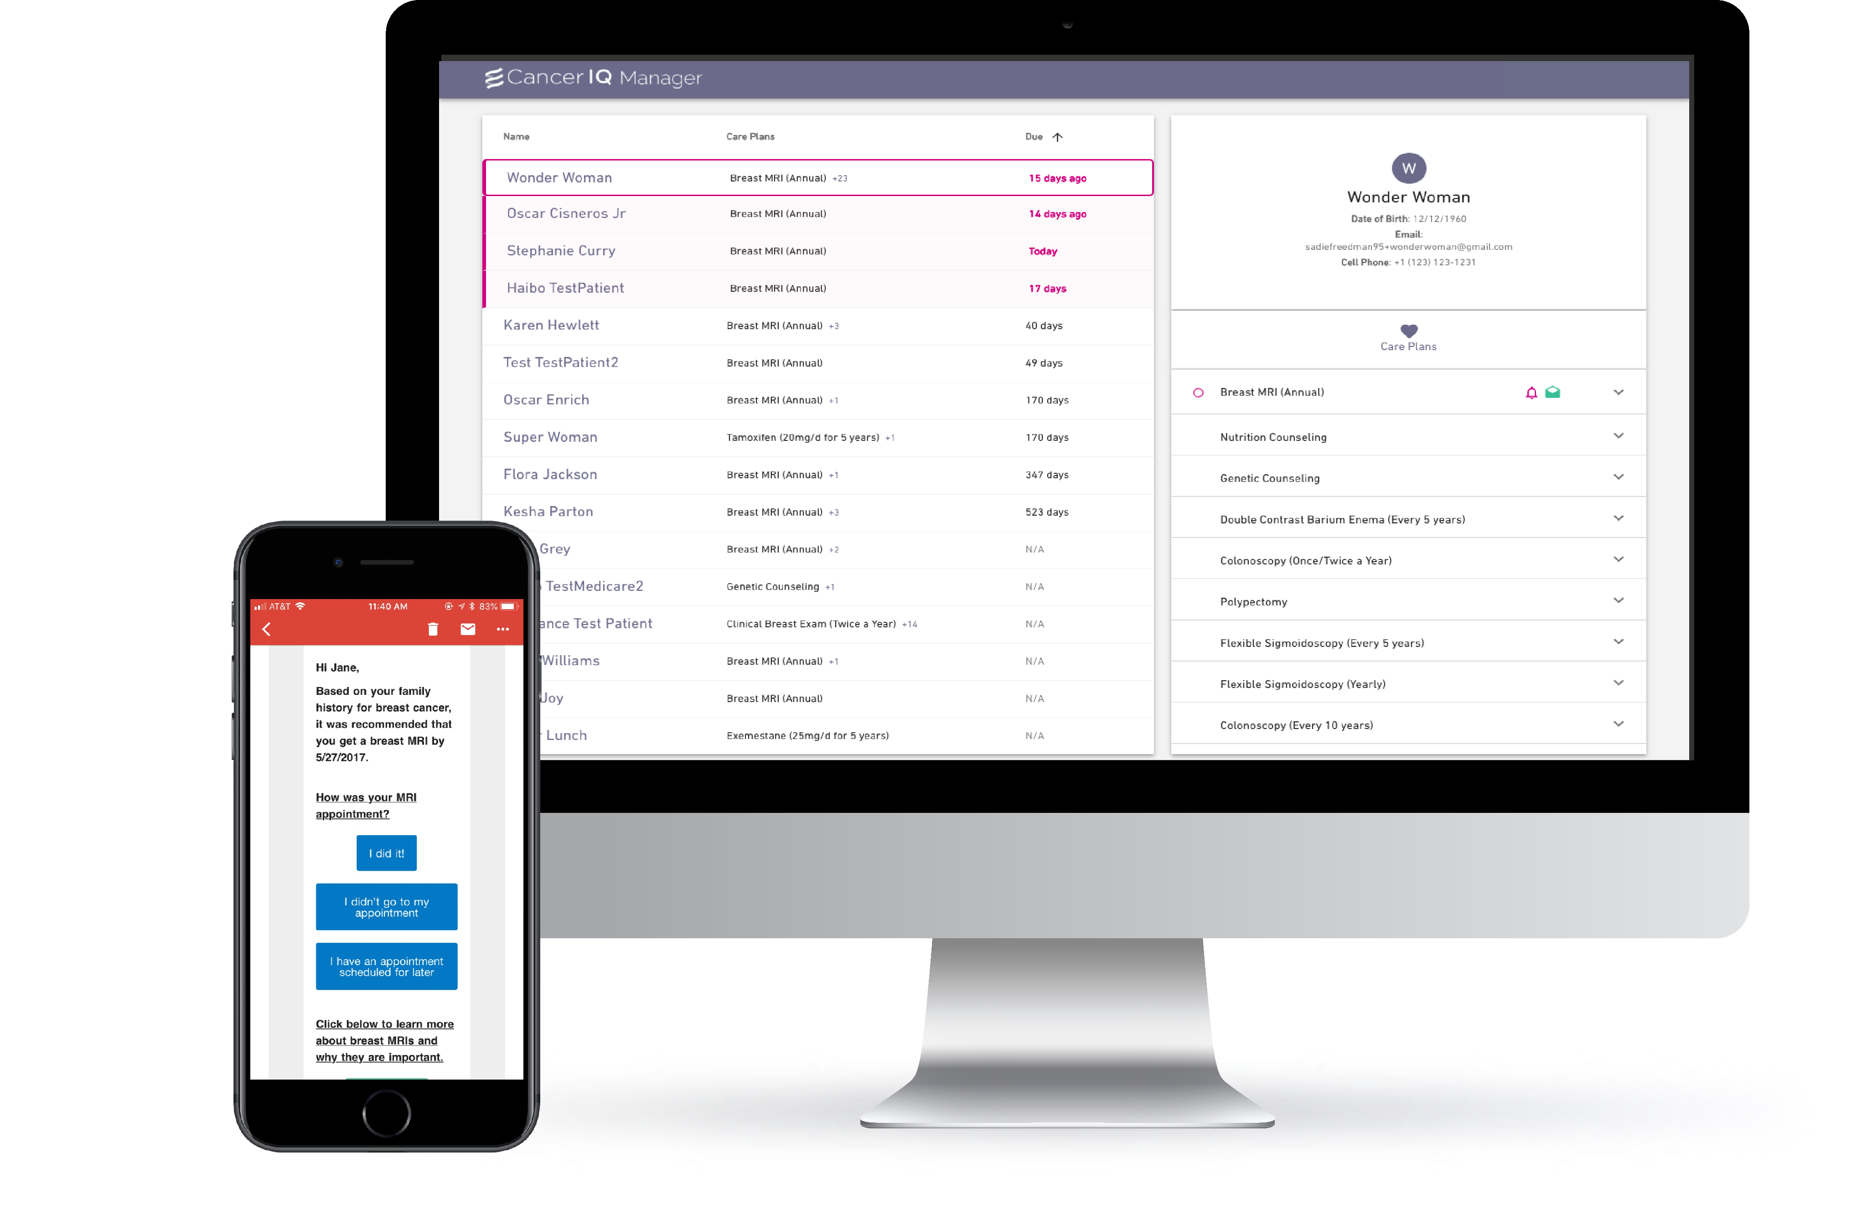
Screening Virtually
1
2
3
Social Media / Website
At Home (via Email/Portal)
In Clinic
Patients find CancerIQ on a website hosted by their provider
Patients receive an email in advance of their appointment from CancerIQ or embed link in portal message.
Patients access questionnaire as part of a virtual check-in process
40,000+
Patient impressions
83,000+
Patients Emailed
300,000+
Patients Screened in Clinic

Slide 8
Launch web or social media campaigns

Slide 9

Embed risk assessment questionnaire on the web
Notes:
https://so2fpg.axshare.com/

Slide 10
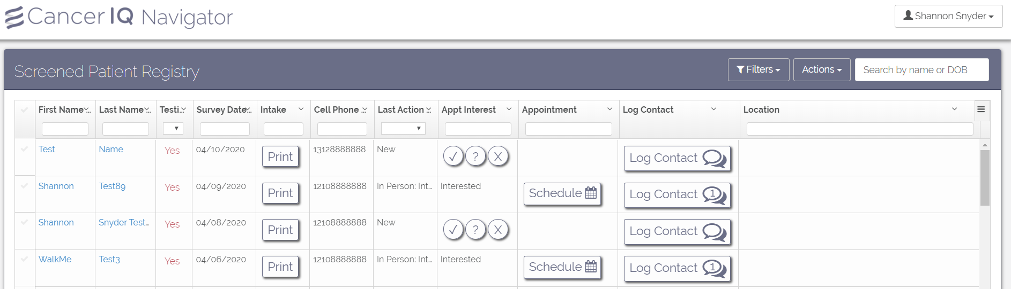
Build pipeline of patients for staff to call and educate
All screened patients will appear on dashboard
  Most recent to oldest
  Evaluate patient risk/eligibility at a glance
  Easy print button to see patient responses

Slide 11
The Outcomes
Digital Marketing Campaign
2,021
  Patients were interested and viewed the content but…
    Needed to understand of who the information was going to
    Communication from the primary care provider was important
0
Patient Views
Patient Completions
Notes:
https://so2fpg.axshare.com/

Slide 12
Proactive screening via email

Slide 13
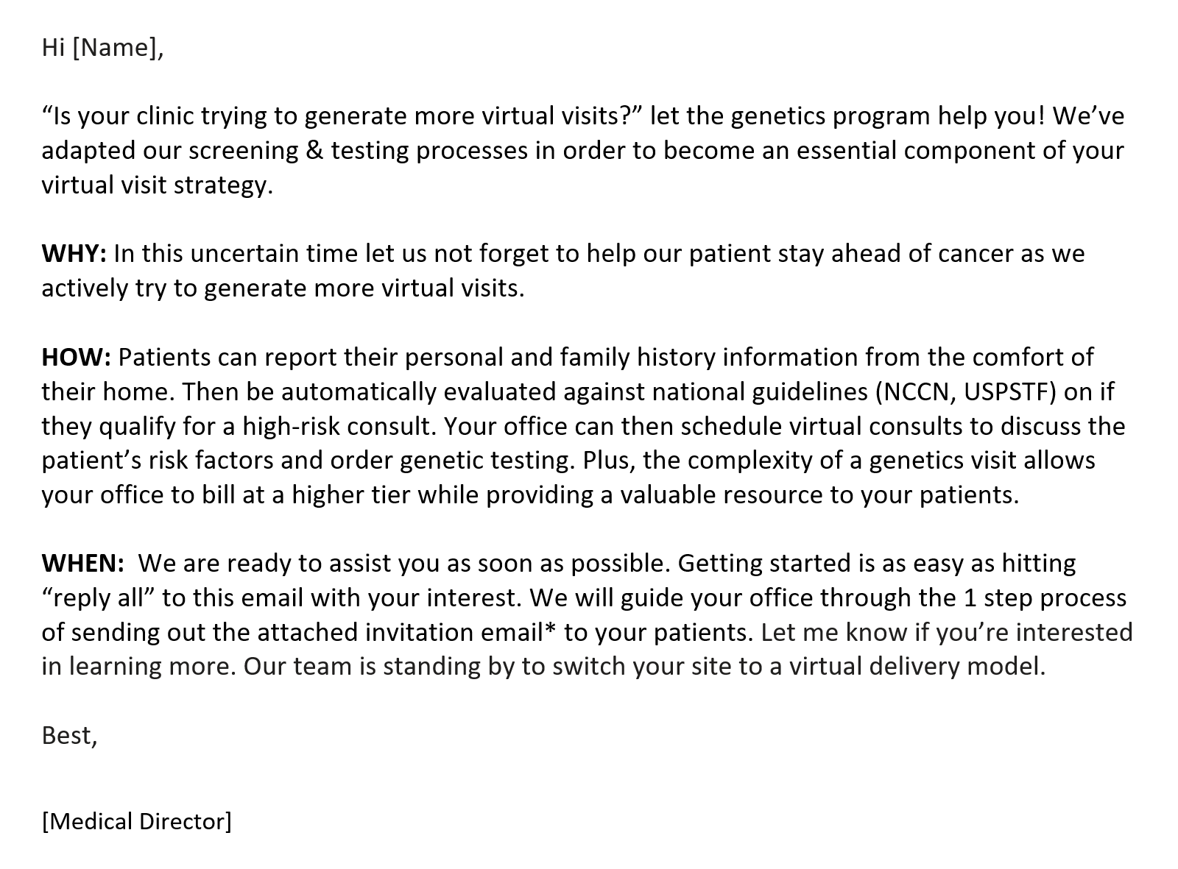
Step 1: Engage Preventative Care Providers
  Benefit: Billing at a higher tier, better quality
  No extra work, we will do everything for you
Notes:
https://so2fpg.axshare.com/

Slide 14
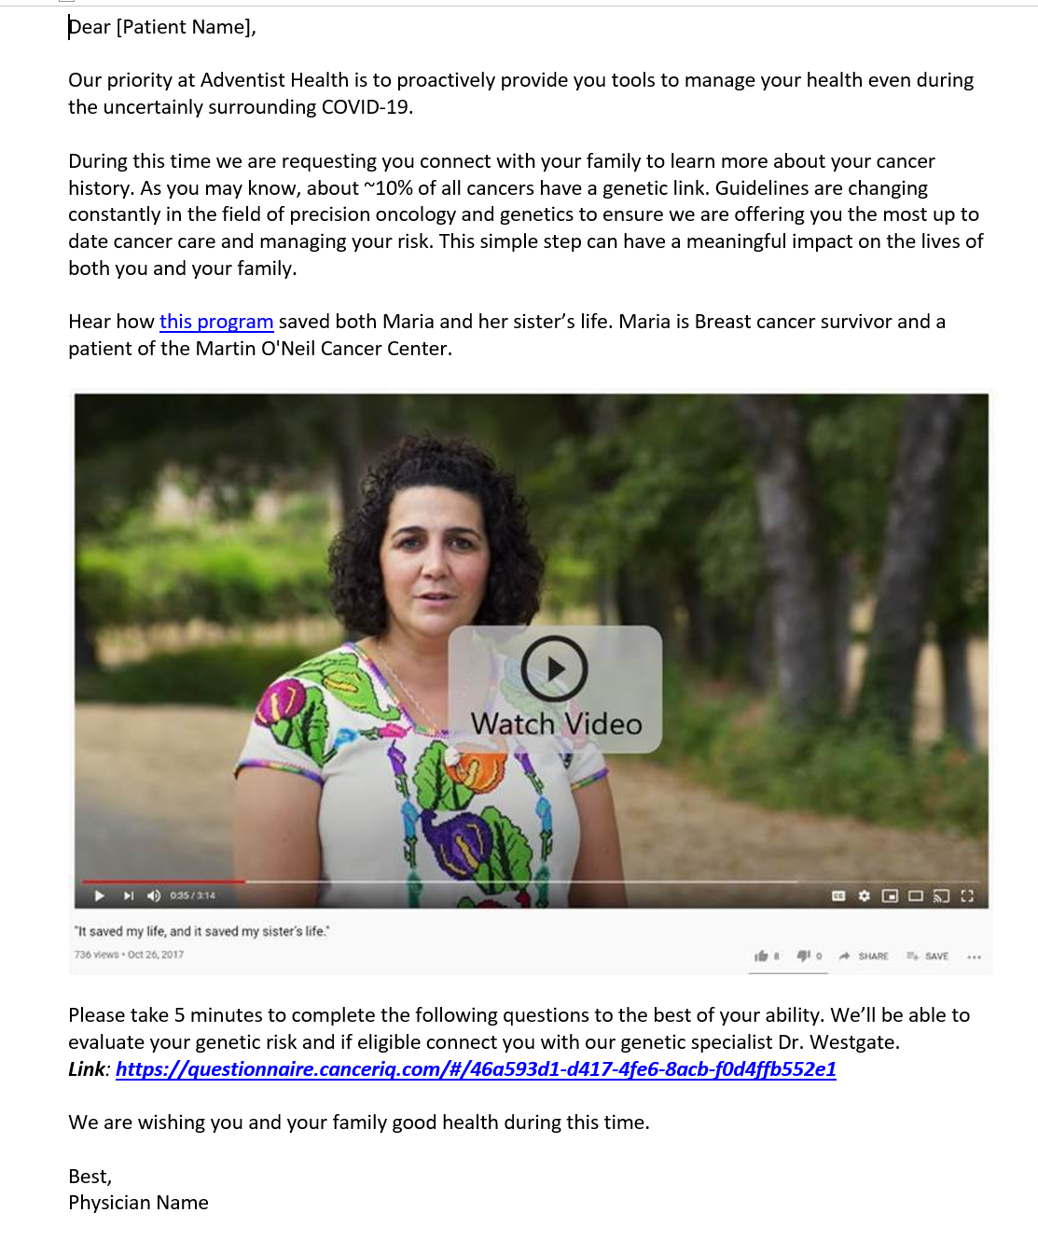
Step 2: Enable Providers to Email Patients
  Why: Changing guidelines, changing care, better outcomes
  Patient Story: Here is a patient who is just like you
  Take Action: Only takes 5 mins
Notes:
https://so2fpg.axshare.com/

Slide 15
Screening in a virtual waiting room

Slide 16
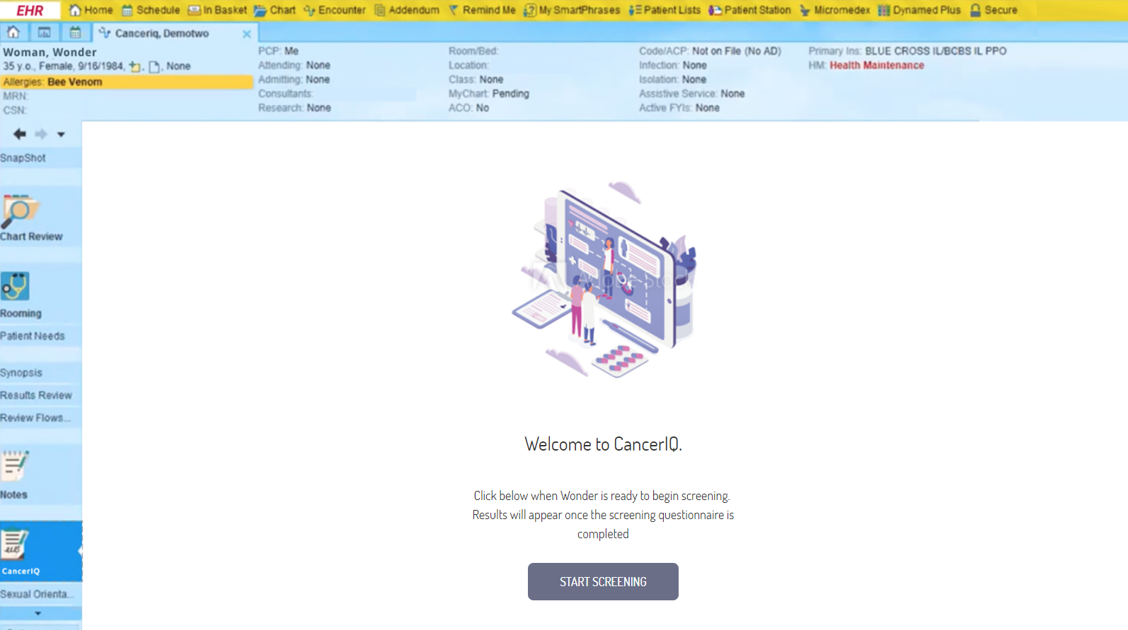
Launch screening from patient chart in EMR
Notes:
https://so2fpg.axshare.com/

Slide 17
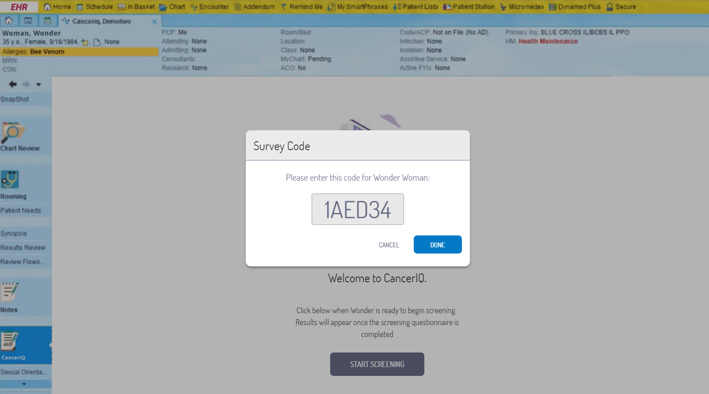
Generate code to link to CancerIQ questionnaire
Notes:
https://so2fpg.axshare.com/

Slide 18
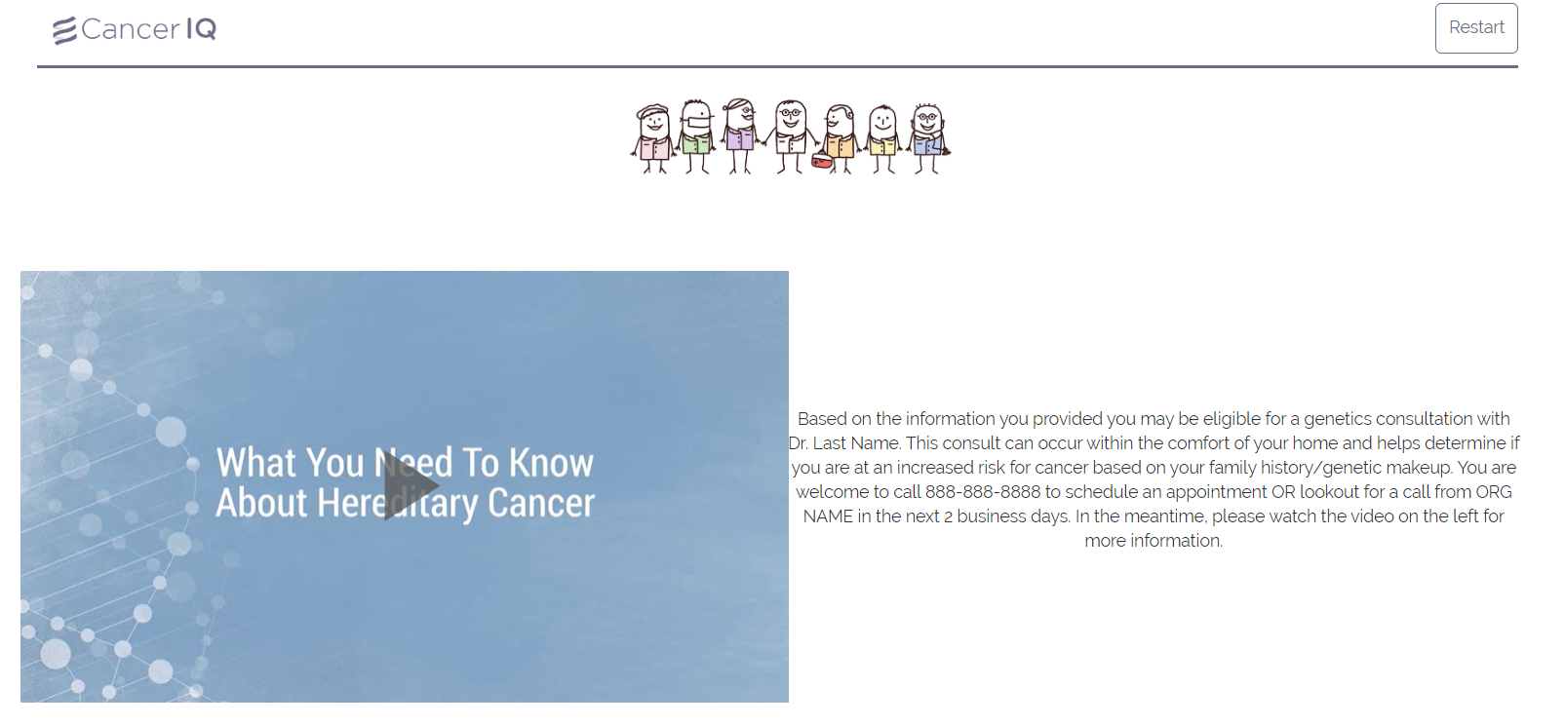
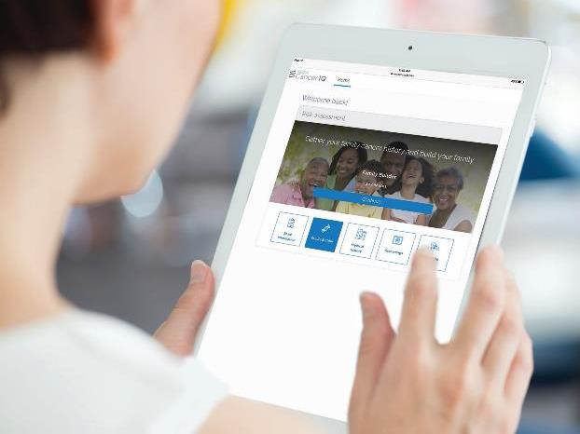
Patient completes screening on phone, tablet or computer
If at risk, the patient can watch educational video prior to a discussion with a provider
Notes:
https://so2fpg.axshare.com/

Slide 19
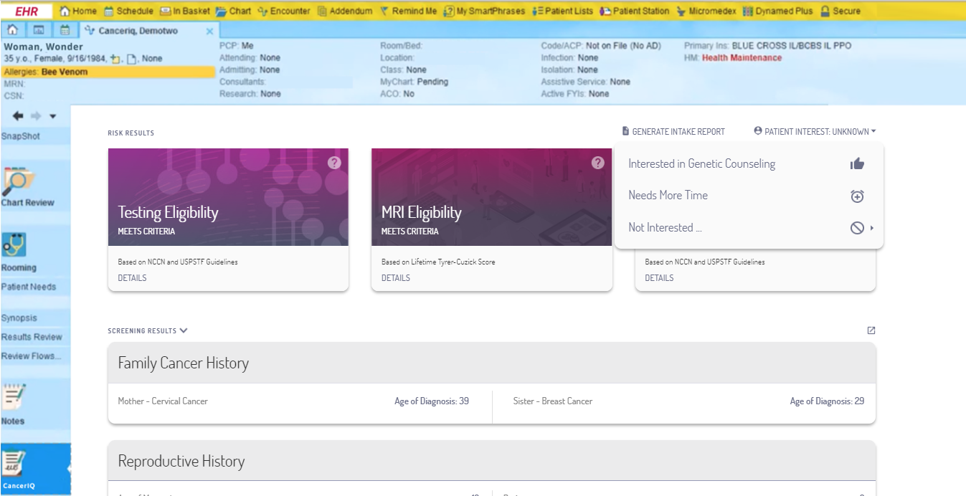
Provider can review and log interest in genetic counseling
Notes:
https://so2fpg.axshare.com/

Slide 20
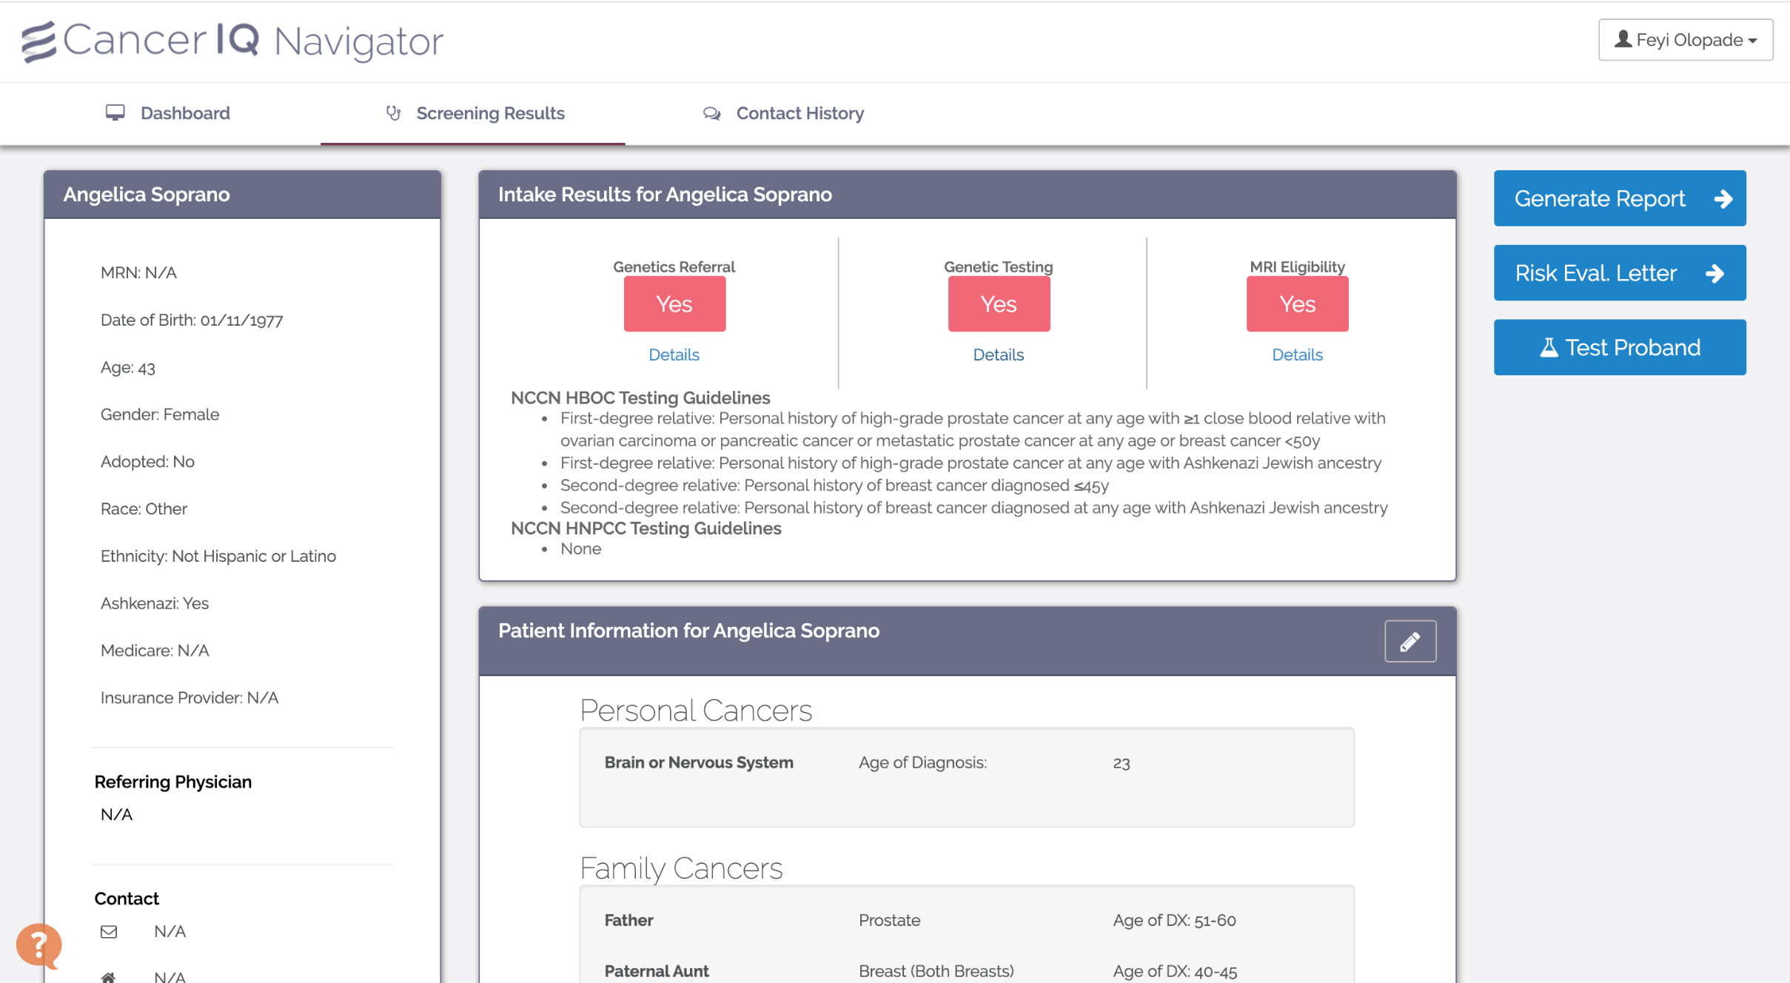
Screen shot of Navigator view without integration

Slide 21
Delivering Virtual Visits
How to streamline the genetic counseling experience with an audio-visual aid

Slide 22










HIPAA Compliant Audio Visual Tools
  The Office of Civil Rights will exercise its enforcement discretion and will not impose penalties for noncompliance with the regulatory requirements under the HIPAA Rules against covered health care providers in connection with the good faith provision of telehealth during the COVID-19 nationwide public health emergency. This notification is effective immediately.
Video software: https://www.hhs.gov/hipaa/for-professionals/special-topics/emergency-preparedness/notification-enforcement-discretion-telehealth/index.html

Slide 23
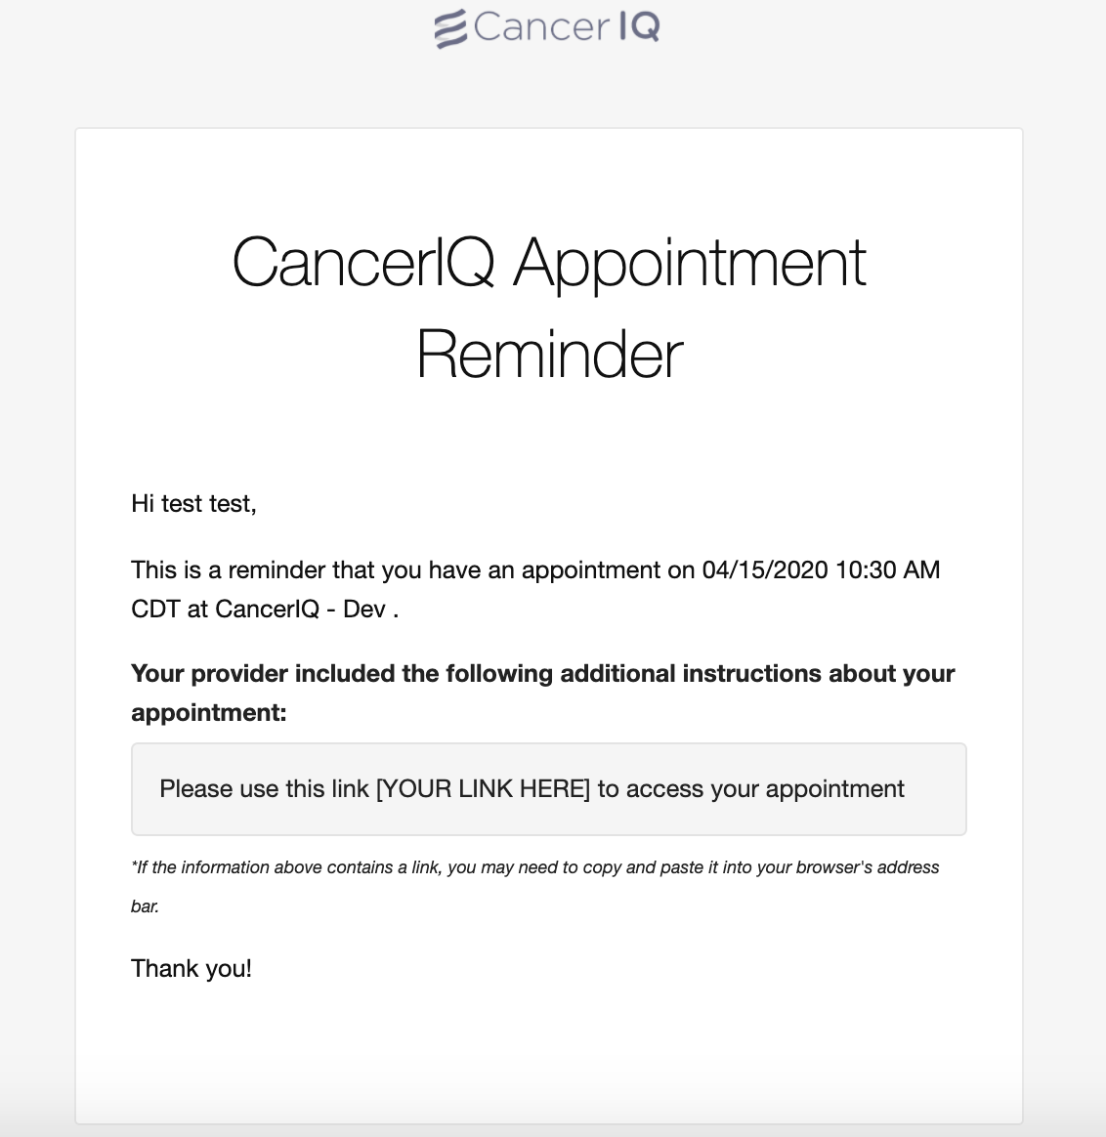
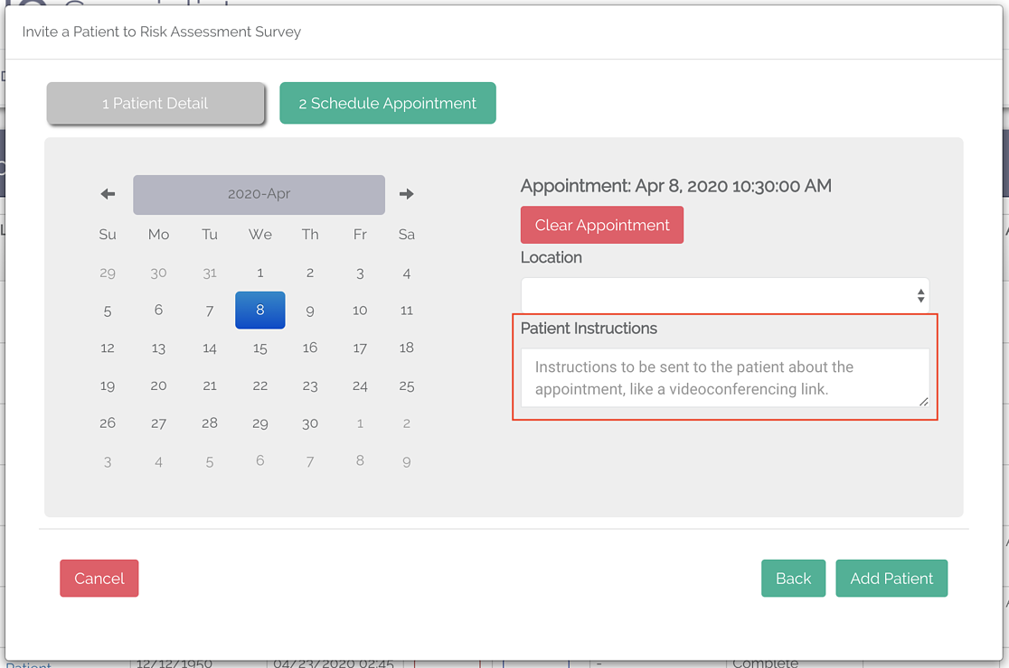
Embed telehealth instructions in pre-visit outreach
Our system can accommodate multiple telehealth vendors
Notes:
And lastly, it comes tools for patients to self-manage their risk, engage in early detection strategies, and ultimately prevent cancer
Our clients can offer genetics services to all patients in a fraction of the time and cost

Slide 24
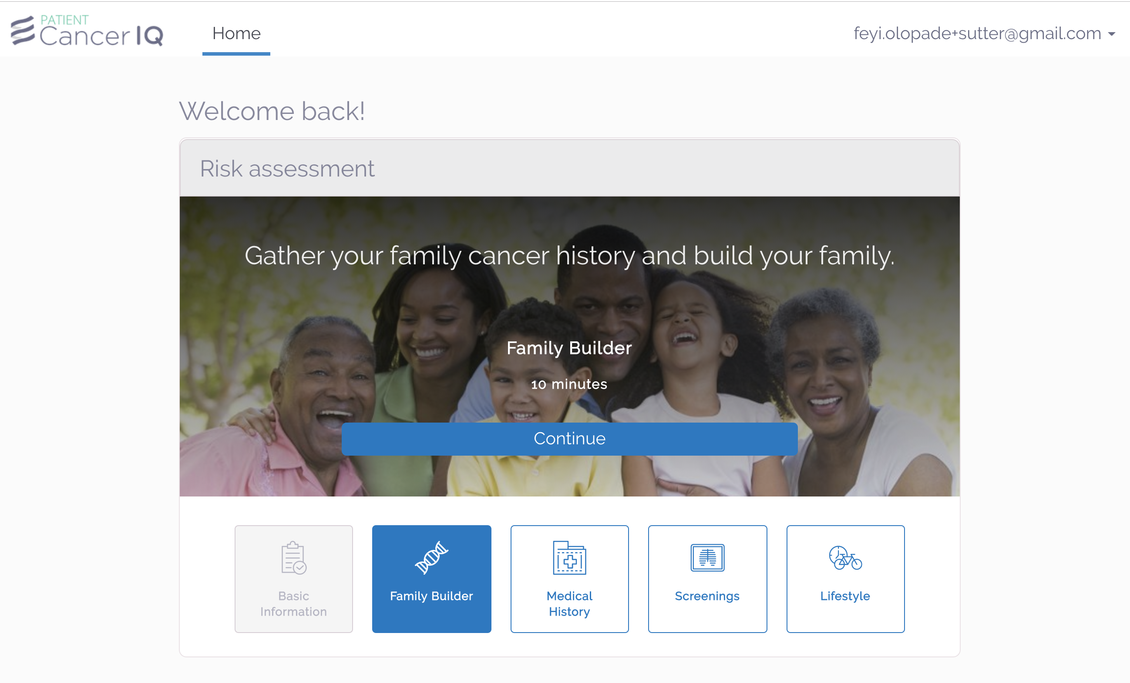
Evaluating Patients Virtually
Notes:
And lastly, it comes tools for patients to self-manage their risk, engage in early detection strategies, and ultimately prevent cancer
Our clients can offer genetics services to all patients in a fraction of the time and cost

Slide 25
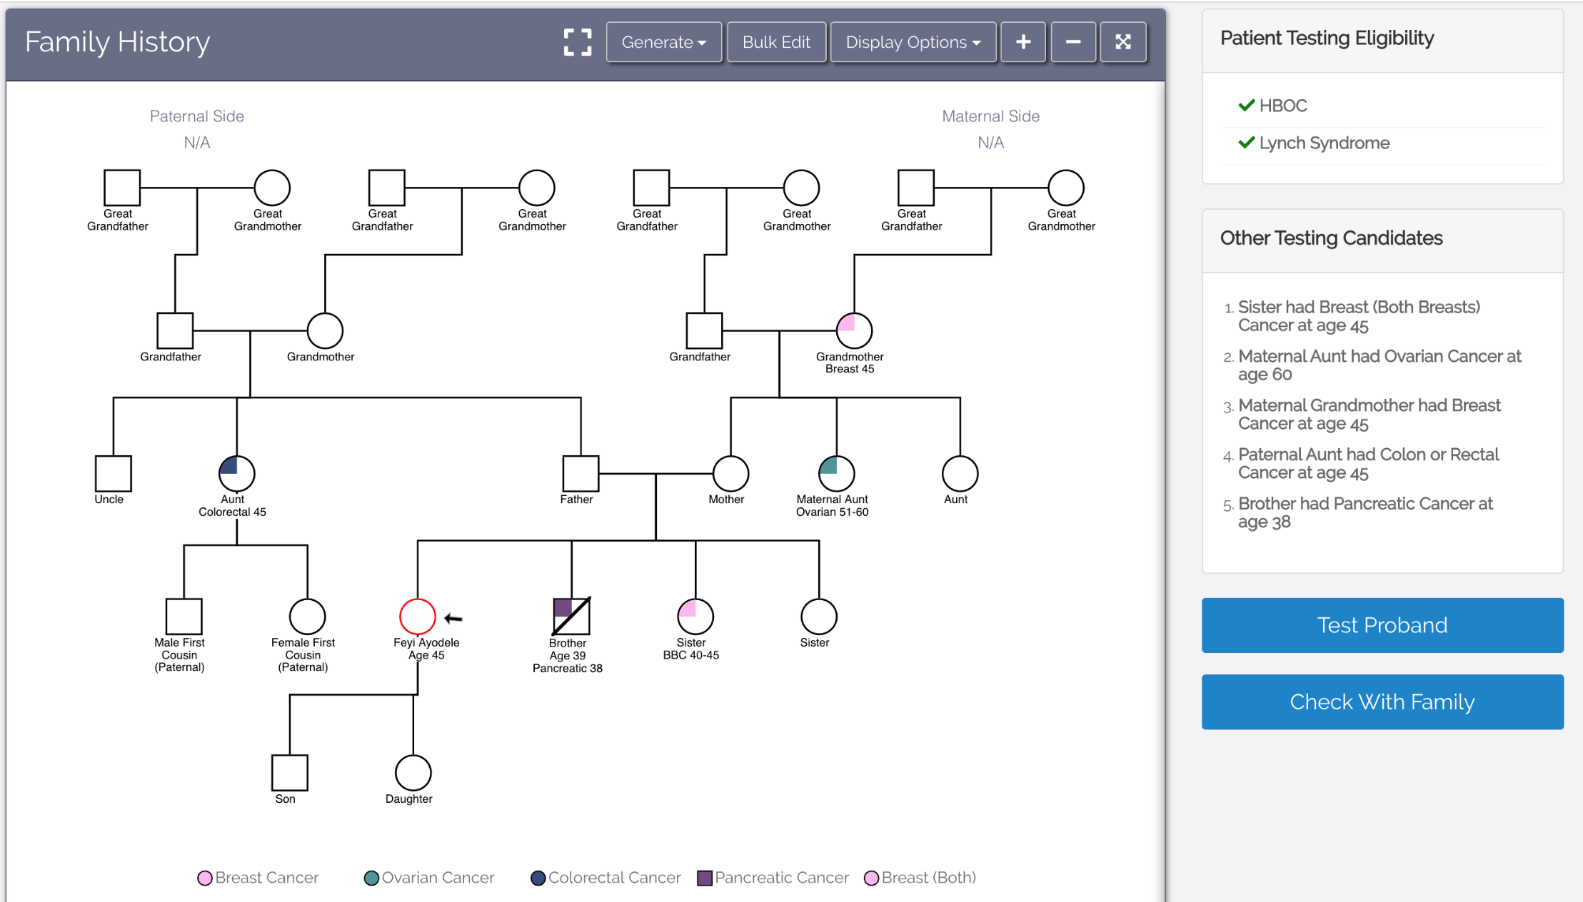
Evaluating Patients Virtually (Cont’d)
Notes:
And lastly, it comes tools for patients to self-manage their risk, engage in early detection strategies, and ultimately prevent cancer
Our clients can offer genetics services to all patients in a fraction of the time and cost

Slide 26
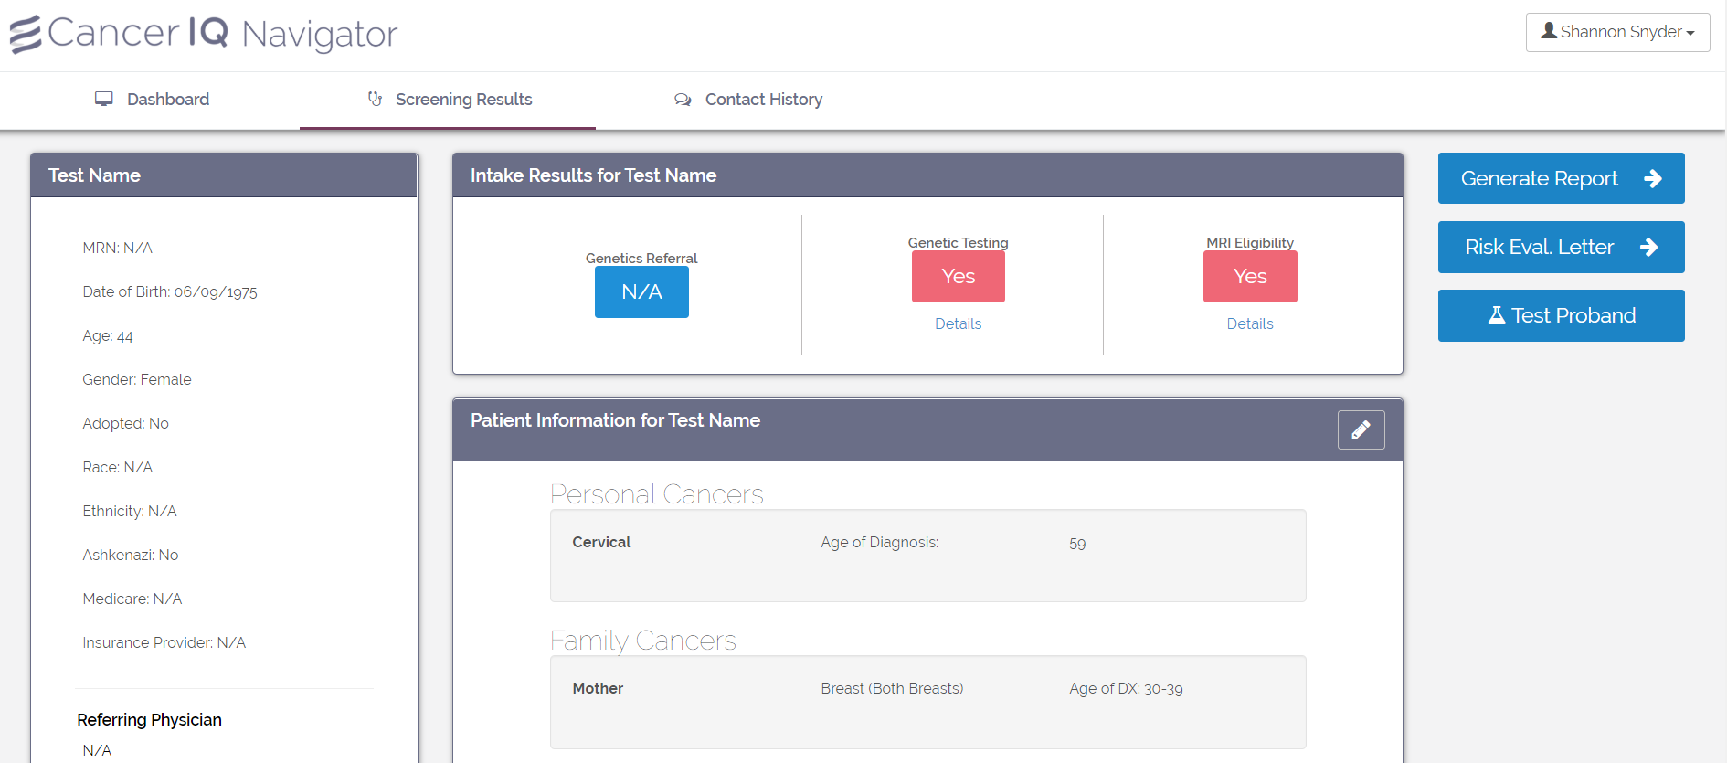
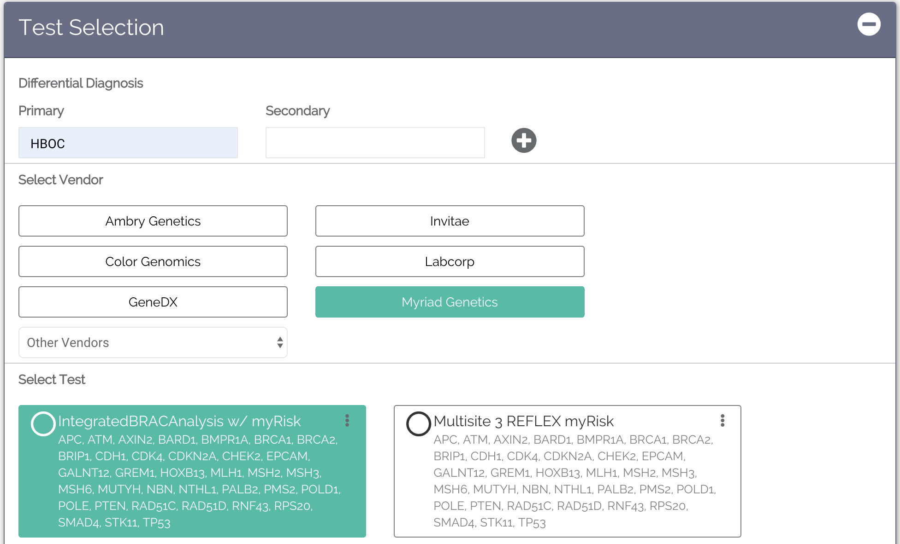
Order a Genetic Test
Notes:
Replace with clicking test

Slide 27
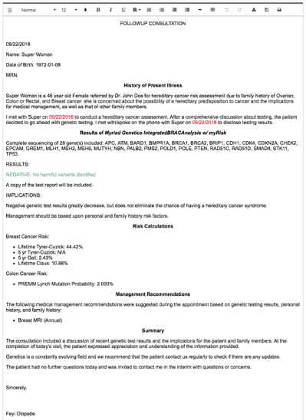
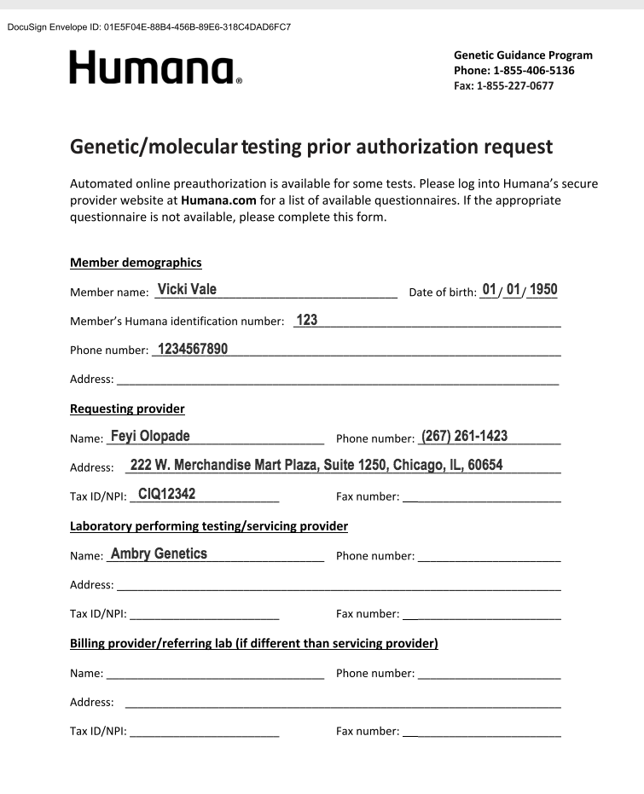
Generate Clinical Documentation & Prior Authorization Paperwork
Consultation Notes:
Prior Authorization Forms
Notes:
And lastly, it comes tools for patients to self-manage their risk, engage in early detection strategies, and ultimately prevent cancer
Our clients can offer genetics services to all patients in a fraction of the time and cost

Slide 28
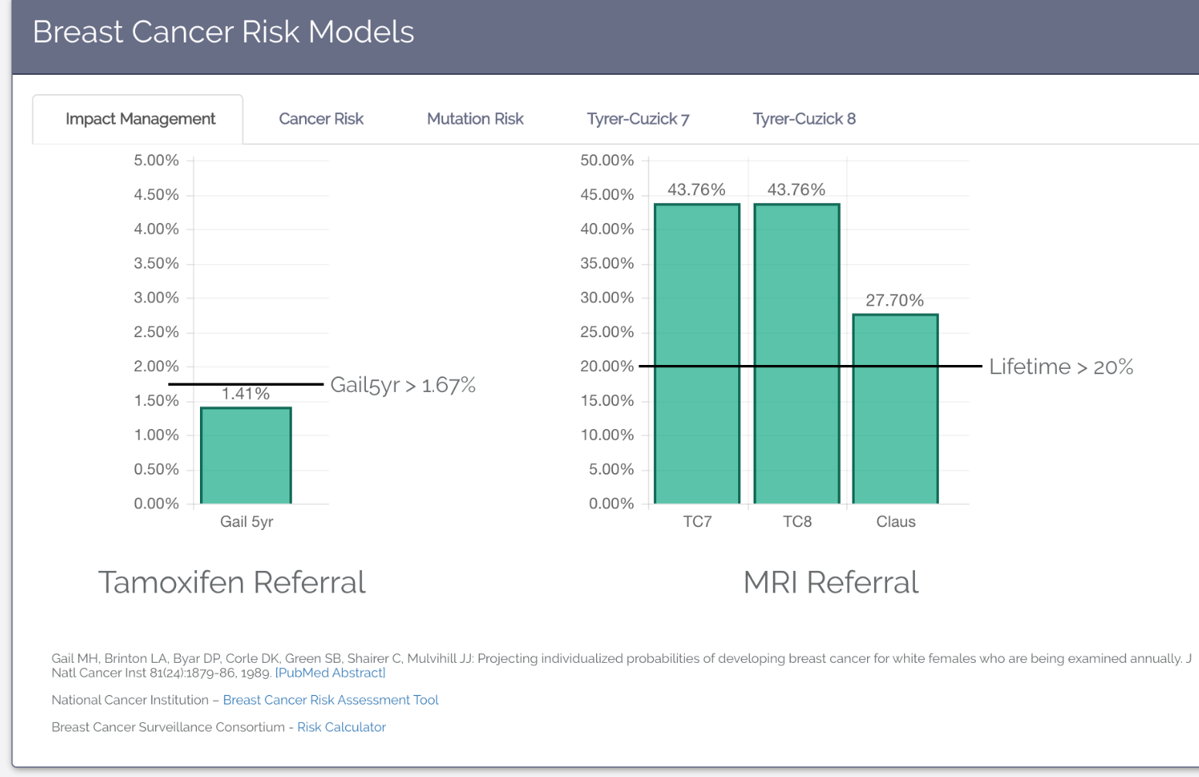
Enter and interpret genetic testing results
Risk Assessment: CancerIQ automatically shows when patients meet thresholds
Relative Risk: Shows the patient their risk over time relative to the population
Notes:
And lastly, it comes tools for patients to self-manage their risk, engage in early detection strategies, and ultimately prevent cancer
Our clients can offer genetics services to all patients in a fraction of the time and cost

Slide 29
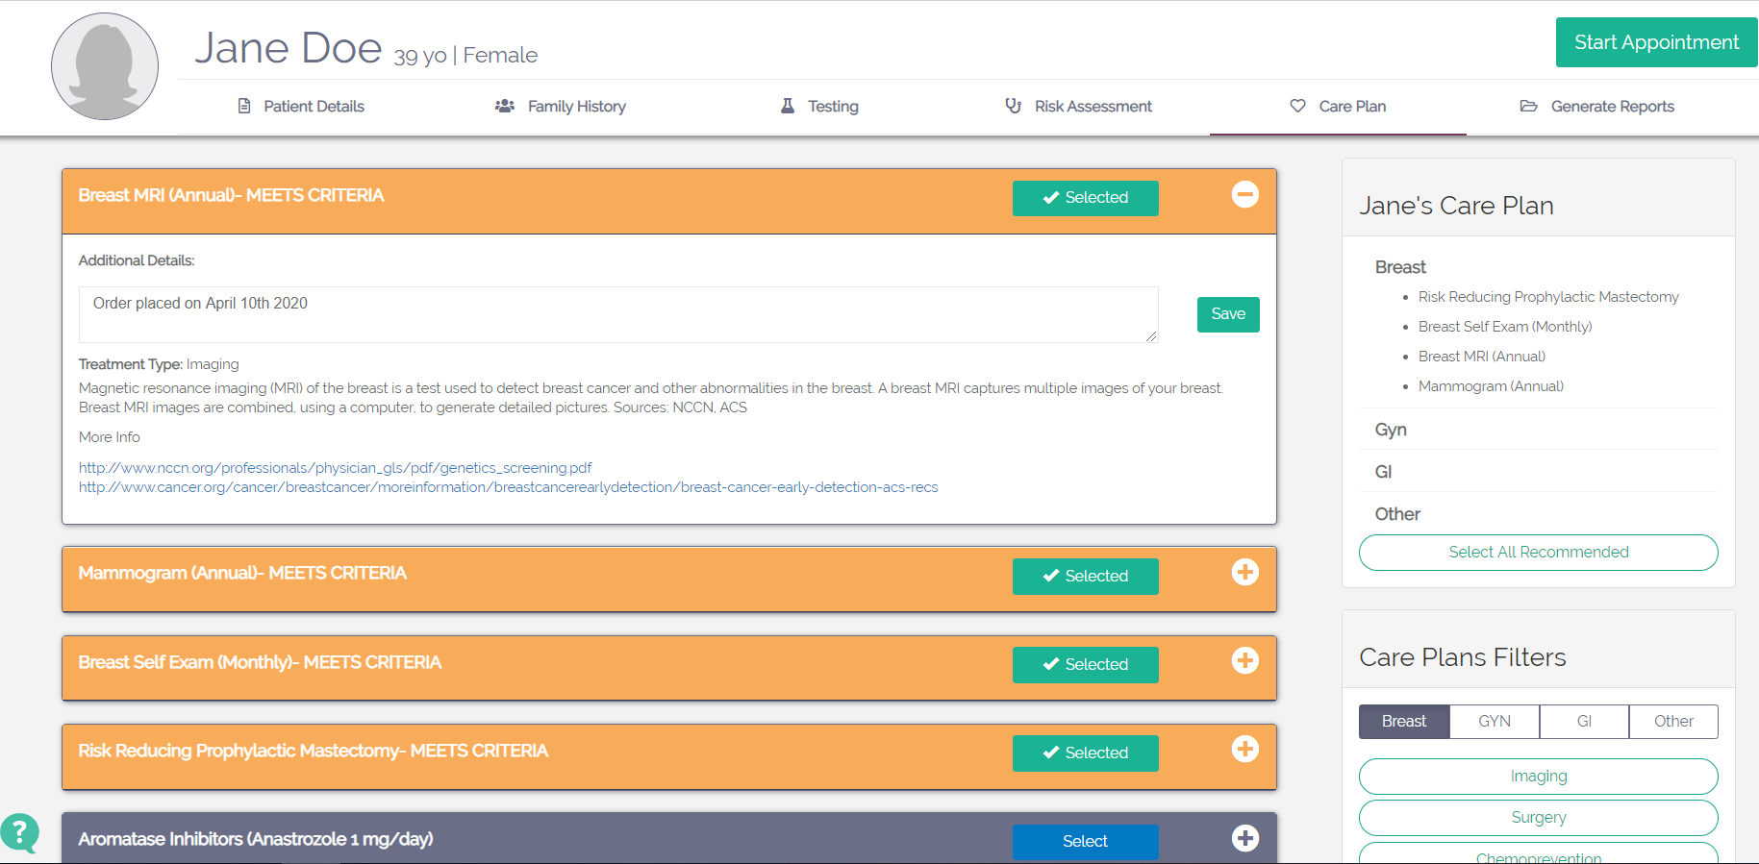
Discuss appropriate care plan based on guidelines
Circle of Care – St. Helena (Dr. Westgate)
Notes:
And lastly, it comes tools for patients to self-manage their risk, engage in early detection strategies, and ultimately prevent cancer
Our clients can offer genetics services to all patients in a fraction of the time and cost

Slide 30
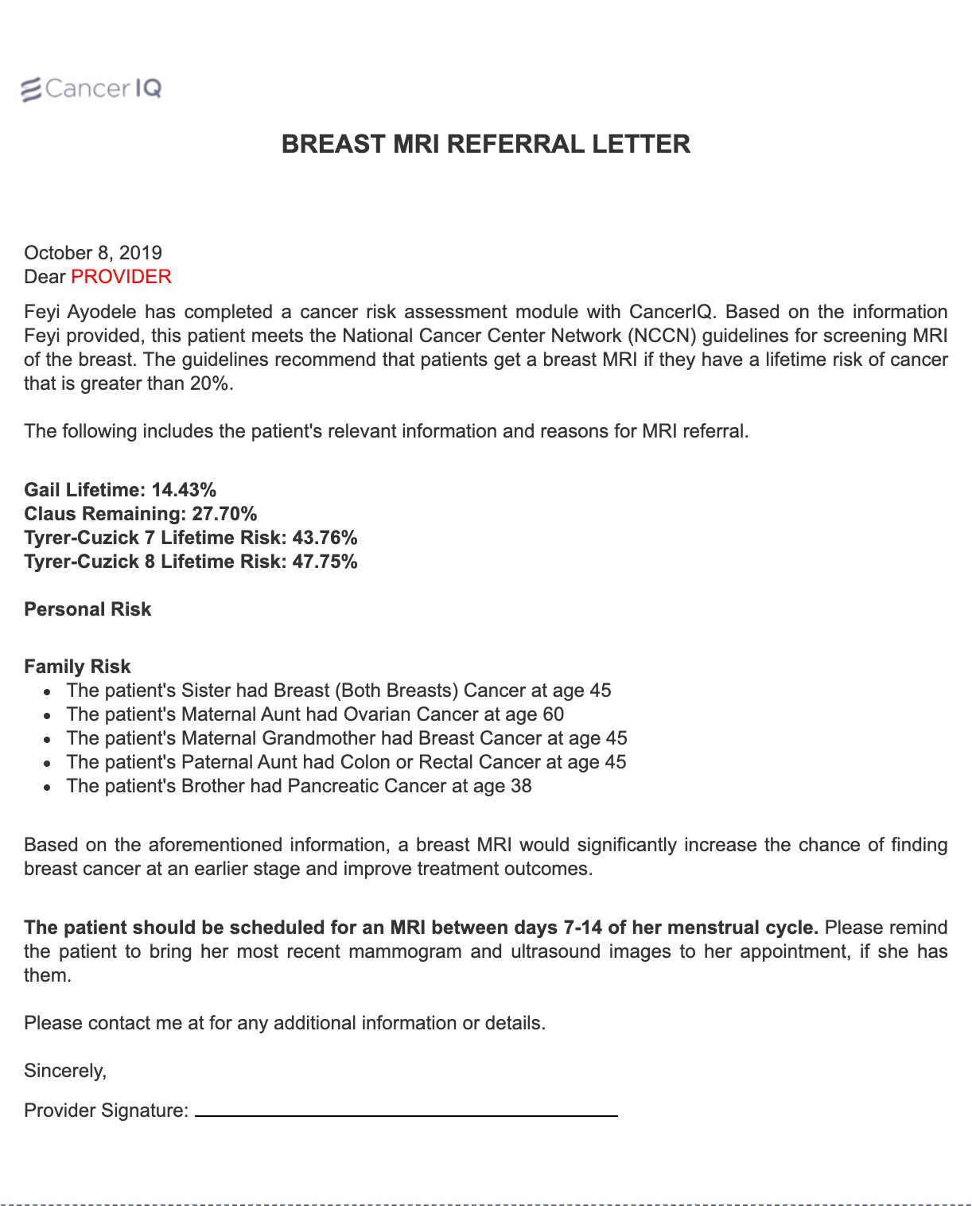
Generate documentation notes and letters of medical necessity so patients can implement high risk management recommendations
Patient Letter:
Breast MRI Prior Auth:
Notes:
And lastly, it comes tools for patients to self-manage their risk, engage in early detection strategies, and ultimately prevent cancer
Our clients can offer genetics services to all patients in a fraction of the time and cost

Slide 31
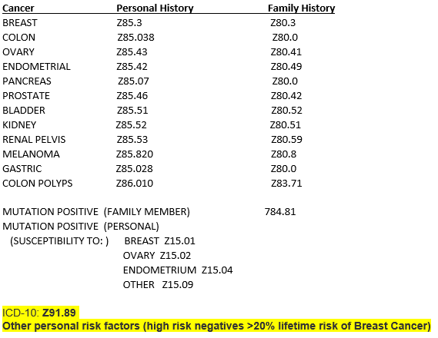
Coding Reference (CPT & ICD-10)
ICD-10 Codes
Provider CPT Codes
New Patient |  | Establish Patients
Code | Duration | Code | Duration
99201 | 10 min | 99211 | 5 min
99202 | 20 min | 99212 | 10 min
99203 | 30 min | 99213 | 15 min
99204 | 45 min | 99214 | 25 min
99205 | 60 min | 99215 | 40 min
Notes:
Use the ICD-10 codes below that match the patient’s family or personal history of cancer, as to why the test was ordered
Use “Mutation Positive” codes once the myRisk result comes back and the patient is diagnosed with a positive gene mutation
Use “Other Personal Risk Factors” code once the myRisk results comes back and the patient is diagnosed as a high-risk negative for lifetime risk of Breast Cancer greater than 20%

Slide 32






If you don’t bill think ahead about downstream revenue
$2k -$10k
per patient
Surgery: Prophylactic surgeries
+
$500 -$1k
per patient
Imaging: MRIs, ultrasounds, and colonoscopies
Preventative Care &
Oncology
Genetics
$250
per patient
Preventative Care: Ongoing management

Slide 33
Managing High-Risk Patients
Actively manage the pipeline of patients with more urgent need for services

Slide 34
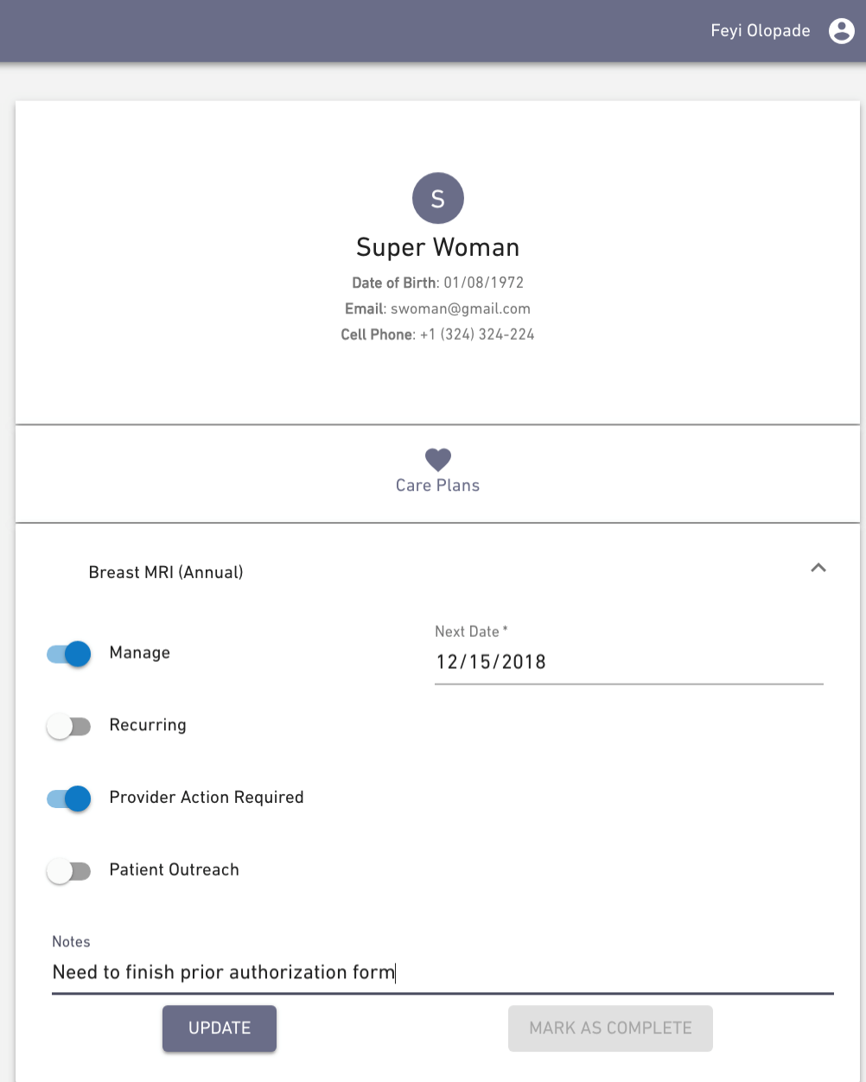
How? Determine which patients need active management
Manage
Alert
Remind

Slide 35
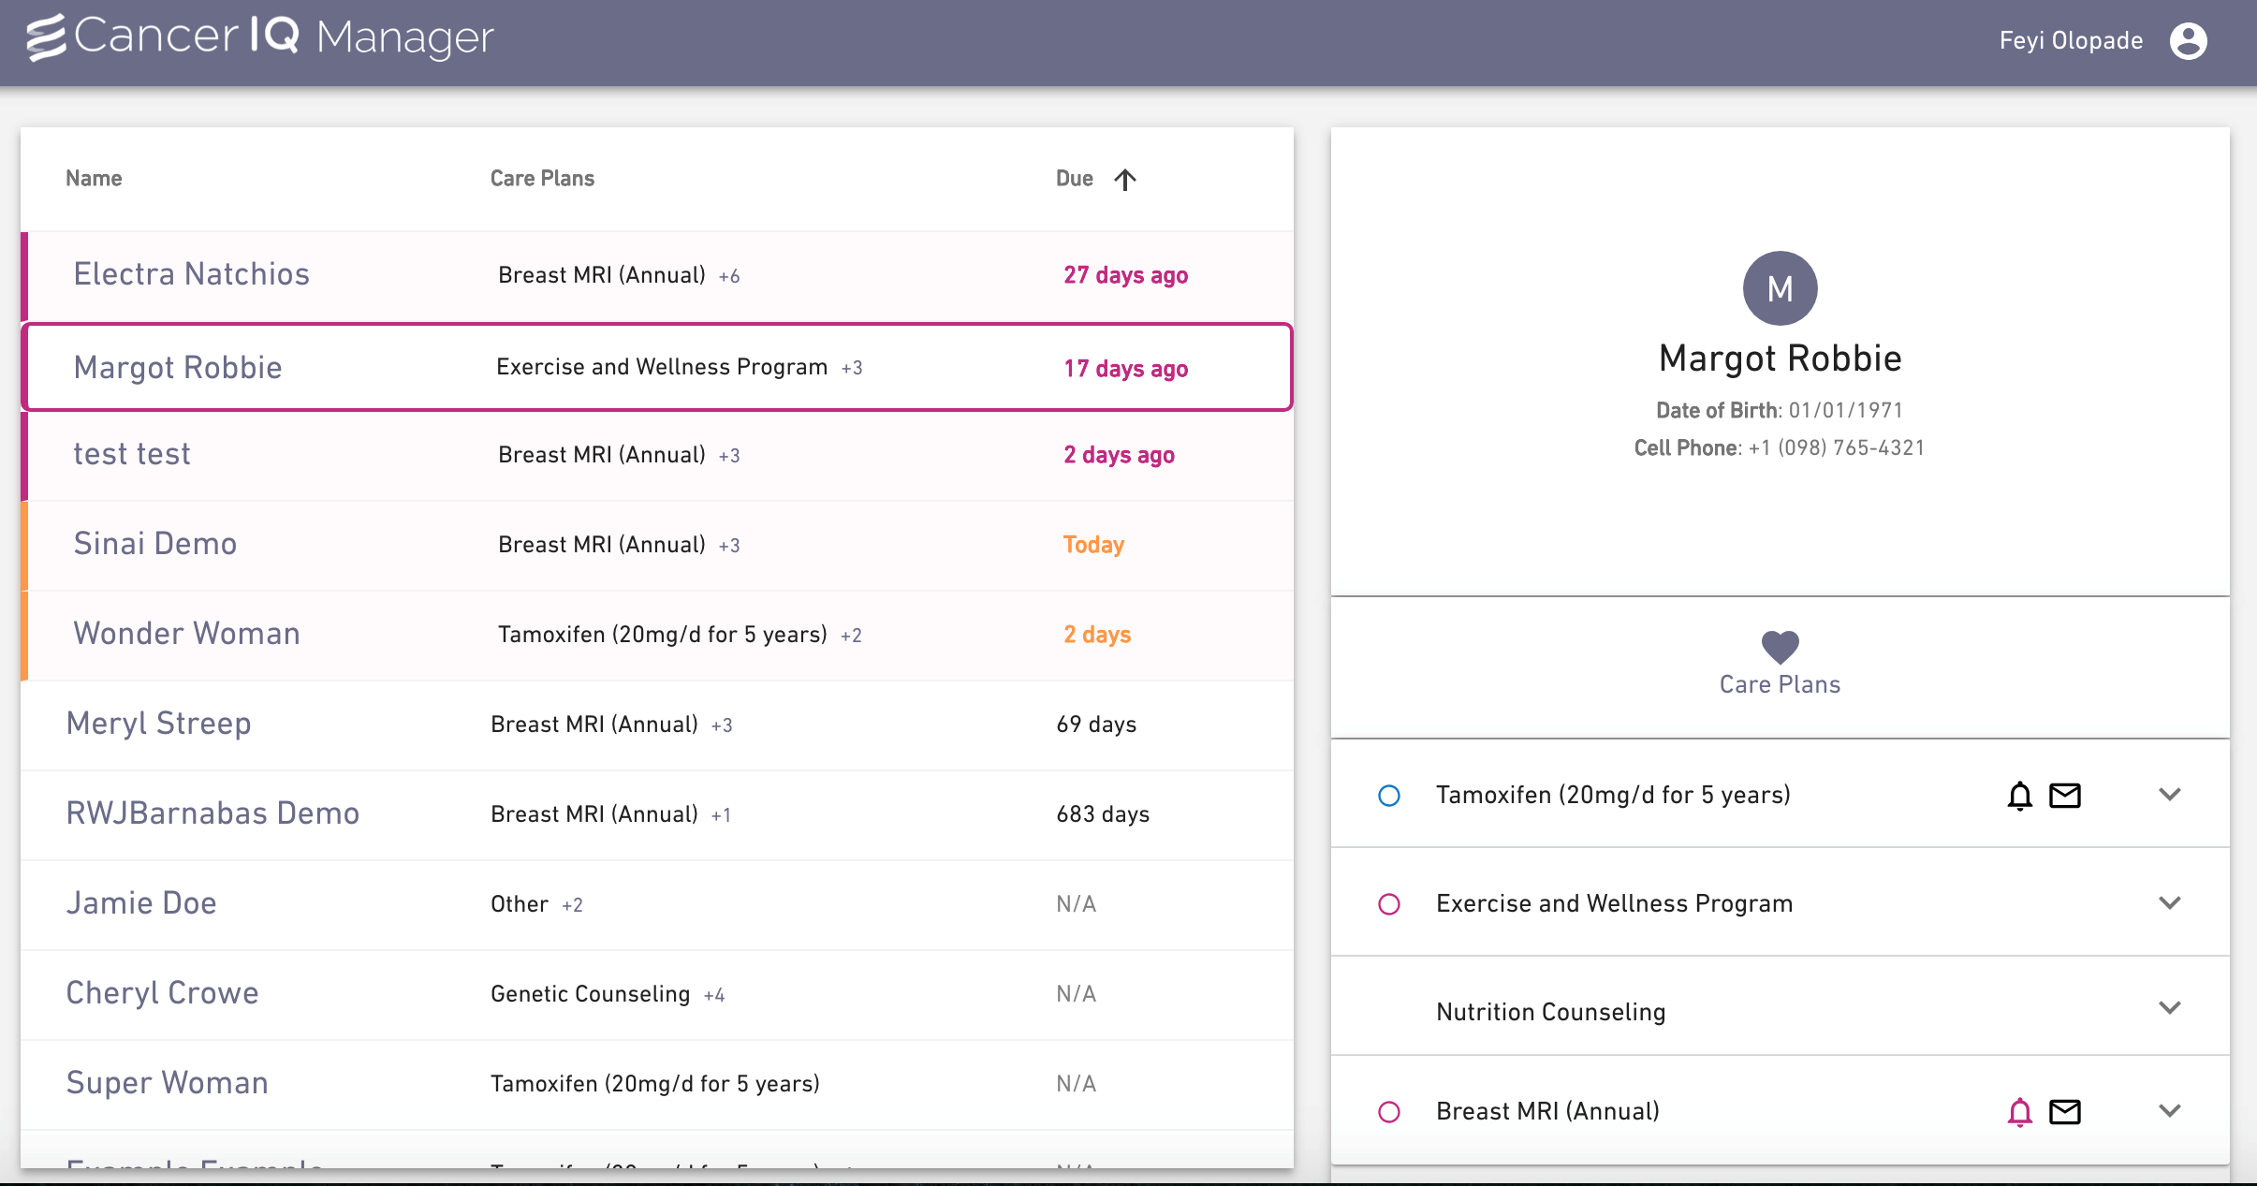
How? Visual alerts of patients that require follow-up
Manage
Alert
Remind

Slide 36
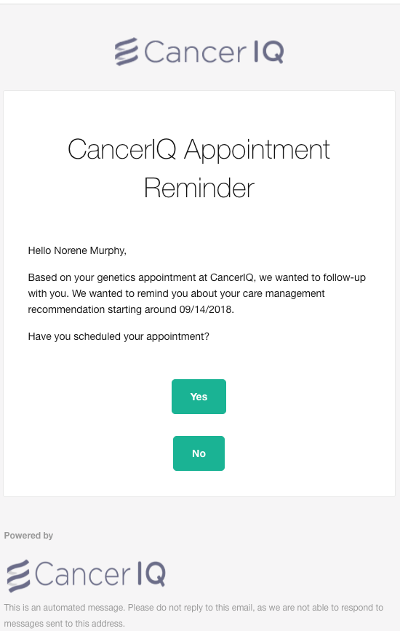
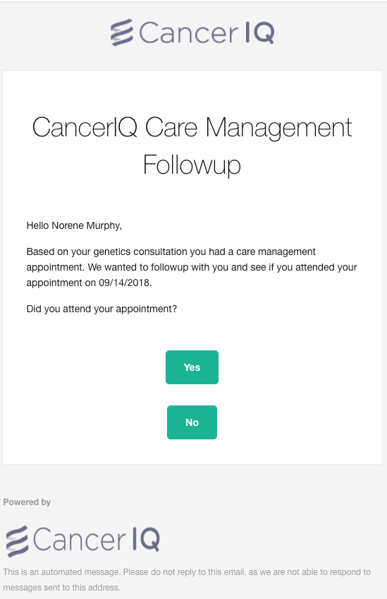
How? Proactive email reminders for patients at risk
Manage
Alert
Remind

Slide 37
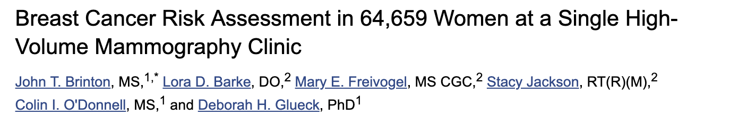
The challenge with adherence to breast MRI recommendations
CancerIQ MRI Adherence
72%
  Traditional Limitations:
  Results were only communicated to providers, not patients
  Gail score was used, and not the Tyrer-Cuzick score
  Reliant on PCPs to know ordering and prior-authorization process
  MRI adherence was only 13.9%
13.9%
Industry
Avg.
CancerIQ

Slide 38
Funding Opportunities for Telehealth
How to secure funding for the appropriate technology

Slide 39
Coronavirus Aid, Relief, and Economic Security (CARES) Act
COVID-19 Telehealth Program
Connected Care Pilot Program
$200m HCPs Telehealth services funds in response to the COVID-19 pandemic
Up to $1m in reimbursement for:
  Telecom Services and Broadband Connectivity Services
  Information Services
  Connected Devices/Equipment
Register with FCC and federal System for Award Management
Rolling applications started 4/13
$100M over three years to defray eligible cost of providing telehealth / connected care services for low income Americans and veterans w/emphasis on chronic conditions such as cancer
FCC will cover 85% of costs for selected projects
Participants in COVID-19 Telehealth Program may not be eligible
Application deadline is 6/31/20, *application not yet open
Notes:
Identifying Patients
Serving Patients
Following up with Patients

Slide 40
Key Selection Criteria
The conditions to be treated: Cancer, cancer predisposition
The goals and objectives: To keep at-risk patient populations out of the hospital
The timeline for deployment: This can be done in less than 10-days, funding can reimburse programs for expenses as far back as March 13th
The factors/metrics to measure the impact: Easy to measure clinical impact, but also interested in number of jobs created or retained by the project
The geographic area and population served: Large underserved or low-income patient population; health care provider shortages; rural hospital closures
The patient population: The health care providers’ targeting of funding to high-risk and vulnerable patients.

Slide 41
Potential scope
1
2
Cancer Screening Sites
3
Preventative Care
Oncology Only
Referral Network
Referral Network
Referral Network
Continue offering genetic counseling services to patients in need of testing for treatment
Proactively screen breast imaging and GI patients, where cancer / cancer risk is top of mind for patients
Screen patients in specialties where professional society guidelines support genetic testing (OBGYN, Surgery)
Oncology Service Line
Quality & Safety, Population Health
The broader the scope, the higher the impact on patients and on job retention

Slide 42
How Our Service Fits In
Key features that align with the COVID-19 Telehealth Program:
  Asynchronous transfer of patient data for interpretation by a physician:
    CancerIQ’s screening solutions gather family history and reproductive history from patients so physicians can interpret their cancer risk and eligibility for genetic testing.
  Platforms and services to provide synchronous video consultation:
    CancerIQ embeds information needed for effective video consultations that allow genetic specialists to show visuals of patient’s family history, and impact of cancer history patterns on the patient’s level of risk.
  Patient reported outcomes:
    CancerIQ’s management solution allows patients to self-report compliance with certain medications and high-risk screening recommendations, so providers can be proactive about getting patient access to care if needed.

Slide 43
Key Components of the Application
Customer
CancerIQ
Obtain FCC Registration #.
Register for an FRN in the Commission’s Registration System (CORES) via: https://apps.fcc.gov/cores/userLogin.do.
Set up an account in CORES by creating a username and an account in the FCC User Registration System.
Include: names, addresses, county, and healthcare provider numbers and the lead healthcare provider for applications involving multiple HCPs
Provide contact information for the individual that will be responsible for the application (telephone number, mailing address, and email address)
Generate a description of connected care services, conditions to be treated, goals and objectives.
Include how COVID-19 impacted the area, the patient population and approx. # pts that could be treated;
If intended to use funds to treat non-COVID pts, describe how this frees up resources that will be used to treat COVID and/or how it prevents, prepares for or responds to the disease (e.g. facilitates social distancing)

Slide 44
Key Components of the Application (Cont’d)
Customer
CancerIQ
Register with the system, go to https://www.sam.gov/SAM/ with the following information:
(1) DUNS number;
(2) Taxpayer Identification Number (TIN) or Employment Identification Number (EIN); and
(3) Your bank’s routing number, your bank account number, and your bank account type, i.e. checking or savings, to set up Electronic Funds Transfer.
Description of estimated number of patients to be treated
Description of services, total amount of funding requested
Supporting documentation for costs such as vendor or service provider quote, invoice or similar info
Timeline for deployment of proposed services and a summary of factors applicant intends to track that can help measure real impact of services
Must certify, at time of application, that they will comply with HIPAA

Slide 45
Getting the Grant Submitted
Draft Customer Section
Finalize Scope
Regroup & Submit
Draft CancerIQ Section
Since the grant is first come, first serve – we can help you navigate through the process in the next week
Notes:
What was the buying process for Magview?
What things did you like or not like?

Slide 46
How to Join a Consortium
Banding together across hospitals to apply as a group

Slide 47
Why join a consortium
Key reasons to join a group:
  If your corporate leadership has $1m of other telehealth priorities
  To deploy across multiple clinical specialties
  To expand the potential patient impact

Slide 48
Thank You
Feyi Olopade Ayodele
Chief Executive Officer
Email: feyi@canceriq.com
Office: +1-312-481-8837
www.canceriq.com

